Slide 1
UNIT –III
CRYSTALLOGRAPHY
DEPARTMENT OF APPLIED PHYSICS

Slide 2
Crystallography
Experimental science of determining the arrangement of atoms in solids and study physical properties of solid.
Scientific study of crystals.

Slide 3
Crystal Structure (Classification)
  Single Crystals:
  Regular periodic arrangement of atoms,
  Distinctive shape,
  Smooth faces and straight edges, Follows law of constancy of angles.
  Possess both short range and long range order. Anisotropic.
  Examples: quartz, rocksalt, alum, diamond etc..

Slide 4
  Polycrystalline Solids:
  fine grains (10³-10⁴ Å single crystals of irregular shape),
  separated by well defined boundaries and oriented in different directions.
  Examples: metals. Isotropic.
  Amorphous Solids:
  No ordered crystalline state.
  Short range order in atomic arrangement.
  Examples: glass, rubber, polymers etc.

Slide 5
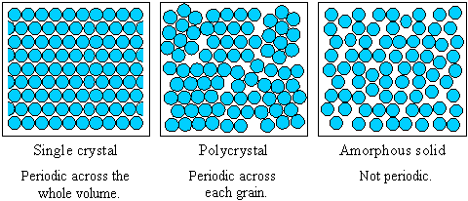

Slide 6
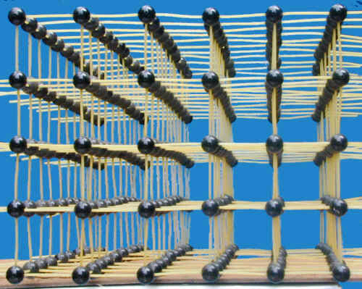
Space Lattice
A Space Lattice is defined as an array of points arranged in a regular periodic fashion in three dimensional space such that each point in the lattice has exactly identical surroundings.
It is a skeleton upon which crystal structure is built by placing atoms on or near the lattice points (14 possibilities).
Lattice points
Lattice lines
Lattice Plane

Slide 7
Net : Two dimensional lattice is called net.
Translation:
l = pa+qb+rc,
a, b, c: translational/basis/primitive vectors

Slide 8
Crystal Structure (Crystal Lattice)
+
=
Basis
Lattice Sites
Crystal Structure
A atom or group of atoms identical in composition, arrangement and orientations is called basis.

Slide 9
Crystal Structure (Unit Cell)
Fundamental block
The unit cell is the smallest geometrical unit , which when repeated in space indefinitely generates the space lattice.
Can be chosen in a number of ways
Is the smallest volume that carries a full description of the entire lattice
Primitive Unit Cell
Unit cell is said to be primitive when the cell has lattice points only at its corner.
Non-primitive Unit Cell
Non –primitive Unit cell may have the lattice points at the corner as well as at the other locations both inside and on the surface of the cell.

Slide 10
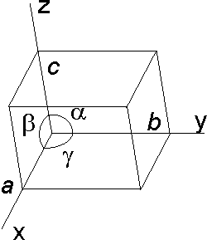
Unit cell
Crystallographic axes : These are the lines drawn parallel to to the lines of intersection of any three faces of the unit cell , which do not lie in the same plane
Lattice constants/Primitives (a, b. c) : The three sides of unit cell are called Lattice constants.
Interfacial angles( α, β, γ) :The angles between the crystallographic axes of the unit cell are called interfacial angles.
Lattice Parameters :The axial lengths a,b,c, and the three interfacial angles α, β, γ are called as Lattice parameters.

Slide 11
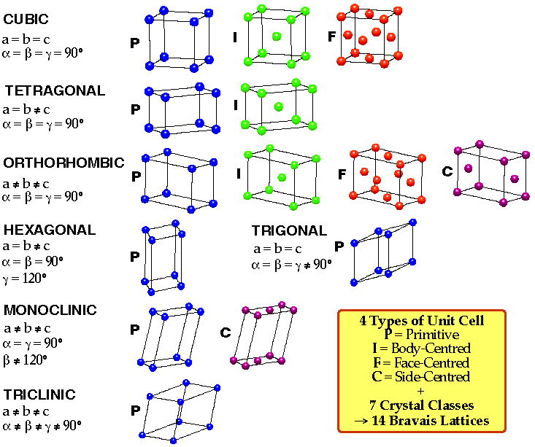
Crystal Systems

Slide 12
Cubic Lattice :
The lattice for which the unit cell is a cube , is called a cubic lattice.
Simple Cubic (SC)
Body Centered cubic (BCC)
Face Centered cubic (FCC)

Slide 13
The Unit Cell Characteristics
Unit Cell Volume, V
V = abc(1-cos²α-cos²β-cos²γ+2cosαcosβcosγ)
Effective Number of Atoms per Unit Cell, Z
Atomic Radius r
Nearest Neighbour distance 2r
Coordination Number, CN
Atomic Packing Fraction, APF
  APF = Zv / V
Void Space
  Void Space = (1- APF) x 100
Density
ρ = ZM / N_{A}V

Slide 14
CHARACTERISTICS OF UNIT CELLS
Unit Cell Volume, V
V = a b c (1-cos²α-cos²β-cos²γ+2cosαcosβcosγ)^{1/2}
For Cubic unit cell a=b= c= &
α=β=γ=90 hence
V = a³ for SC, BCC & FCC unit cell

Slide 15
2. Effective Number of Atoms per Unit Cell, Z
Simple Cubic Cell (SC)
Body centered Cubic (BCC)
Face Centered Cubic (FCC)
Z = 1/8 x 8 ( corners/cell)
Z = 1 atom/unit cell
Z = 1(body centre atom/unit cell)
+1/8x 8( corners/cell)
Z = 2 atoms/unit cell
Z = ½ (atom/face) x 6(faces/unit cell)
+1/8x 8( corners/cell)
Z = 4atoms/unit cell

Slide 16
3. Atomic radius , r
Simple Cubic Cell (SC)
Body centered Cubic (BCC)
Face Centered Cubic (FCC)
Face diagonal AG = 4r
AC² = AB² + BC²
(4r)² = a² + a²
(4r)² = 2a²
r =(√2/4) a = a / (2√2)
2r = a
r = a/2
Body diagonal AG = 4r
AG² = AC² + CG²
= (AB² + BC²) + CG²
(4r)² = a² + a² + a²
(4r)² = 3a²
r =(√3/4) a

Slide 17
4. Nearest neighbour distance, 2r
Simple Cubic Cell (SC)
Body centered Cubic (BCC)
Face Centered Cubic (FCC)
r = a/2
2r = a
r =(√3/4) a
2r = (√3/2) a
r = a / (2√2)
2r = a/√2

Slide 18
5. Coordination Number, CN
Simple Cubic Cell (SC)
Body centered Cubic (BCC)
Face Centered Cubic (FCC)
CN = 6
CN = 8
CN = 12

Slide 19
6. Atomic Packing Fraction
Simple Cubic Cell (SC)
Body centered Cubic (BCC)
Face Centered Cubic (FCC)
APF = (Z υ)/V
For SC cell, Z = 1
=volume of spherical
atom
= 4/3πr³
V = volume of the unit cell
= a³ = (2r)³ = 8r³
APF = [1 x (4/3πr³)] / (8r³)
APF = π/6 = 0.52
APF = (Z υ)/V
For BCC cell, Z = 2
=volume of spherical
atom
= 4/3πr³
V = volume of the unit cell
= a³ = (4r/√3)³ = 64r³ /3√3
APF = [2 x (4/3πr³)] / [64r³/ 3√3]
APF = π √3 /8 = 0.68
APF = (Z υ) /V
For FCC cell, Z = 4
=volume of spherical
atom
= 4/3πr³
V = volume of the unit cell
= a³ = (2√2r)³
APF = [4 x (4/3πr³)] / [16√2r³]
APF = π /3√2 = 0.74

Slide 20
6. Voids Space
Void Space = [1- APF] x 100
Simple Cubic Cell (SC)
Body centered Cubic (BCC)
Face Centered Cubic (FCC)
Void Space = [1-0.52] x 100 = 48%
Void Space = [1-0.68] x 100 = 32%
Void Space = [1-0.74] x 100 = 26%

Slide 21
7.Density ρ
ρ = Mass/Volume = ZW/V ;
where W = mass of each atom given by M/N_{A}
where M is molecular weight of the material and N_{A} is Avogrado number
Hence ρ = ZM/(VN_{A})
Simple Cubic Cell (SC)
Body centered Cubic (BCC)
Face Centered Cubic (FCC)
ρ = ZM/VN_{A}
for SC, Z = 1
Hence, ρ = 1M/(N_{A}a³)
ρ = ZM/VN_{A}
for BCC, Z = 2
Hence, ρ = 2M/(N_{A}a³)
ρ = ZM/VN_{A}
For FCC, Z = 4
Hence, ρ = 4M/(N_{A}a³)

Slide 22
Voids
The vacant space between the atoms in the crystal are called voids or interstices
Three dimensional arrangement of spheres gives rise to voids between their curved surfaces
Mainly two kinds of voids in a close packed structure
  Tetrahedral
  Octahedral

Slide 23
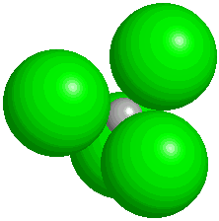
Tetrahedral Void
Produced by a sphere fitting into the valley formed between three adjacent spheres of a closed pack structure.
If centers of four atoms are joined, a regular tetrahedron is produced
The vacant site enclosed by the tetrahedron is called tetrahedral void
If fourth sphere belongs to upper layer- upright tetrahedral void, else, inverted..

Slide 24
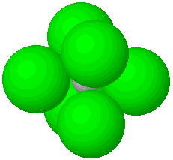
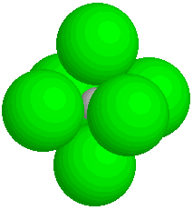
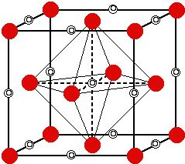
Octahedral Void
Produced when a void formed by three adjacent spheres in one layer comes on the top of the void formed by three spheres in contact in the adjacent layer
Surrounded by six spheres
The centers of the three spheres in a layer comes exactly on the top of the triangular peripheral valleys formed by the spheres in the bottom layer
Octahedron is obtained on joining centers of six spheres, hence space enclosed is called octahedral void

Slide 25
Tetrahedral | Octahedral
Two voids per sphere | One void per sphere
Surrounded by four atoms | Surrounded by six atoms
Smaller in size and greater in number | Bigger in size and smaller in number

Slide 26
Miller Indices
Miller Indices are the reciprocals of the intercepts made by the plane on the crystallographic axes, when reduced to smallest integers.
Procedure for finding the Miller Indices
Identify the intercepts of planes along three crystallographic axes (The coordinates of the points of interception are expressed as integral multiples of the axial lengths in the respective directions)
Determine the reciprocals of the integers
Reduce the reciprocals to the smallest set of integers h, k, l by taking LCM
(h k l) represent Miller Indices

Slide 27
Miller Indices
z
G
Plane
ABCD
BEFC
ABEG
E
intercepts
1 ∞ ∞
∞ 1 ∞
∞ ∞ 1
A
B
y
reciprocals
1 0 0
0 1 0
0 0 1
O
F
Miller Indices
D
(1 0 0)
(0 1 0)
(0 0 1)
x
C

Slide 28
Family of Symmetry Related Planes
Z
( 1 1 0 )
( 1 0 1 )
( 0 1 1 )
Y
( 1 1 1 )
X
( 2 2 1 )

Slide 29
Interplanar Distance in the Cubic Crystal
Let d_{hkl} represent the distance between two adjacent parallel planes having Miller Indices (hkl)
Let ABC be one
of the planes
D
γ
α
β
Perpendicular OD
from the origin to
the plane = d_{hkl}
O
Cosα = OD/OA = hd/a
Cosβ = OD/OB = kd/b
Cosγ = OD/OC = ld/c
Direction cosines
of OD: cosα,cosβ,
cosγ
OA = a/h
OB = a/k
OC = a/l

Slide 30
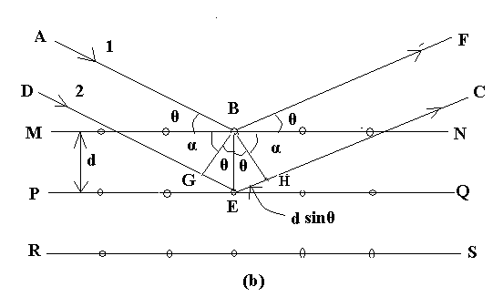
Braggs law of X ray diffraction
Path difference is
Δ =GE + EH
For constructive interference
Δ =GE + EH = mλ
d .sinӨ+d. sinӨ=mλ
2d.sinӨ =m λ
Which is Bragg’s Law

Slide 31
THANK YOU

